Slide 1
WELCOME TO OUR PRESENTATION Champa rani som 06-office 35

Slide 2

Takeover Tactics
During the 1980s merger wave, powerful tactics like bear hugs, tender offers, and proxy fights emerged to counter strong antitakeover defenses. Tender offers became the most common, while proxy fights gained traction in the 1990s as financing challenges arose. Each tactic's success depended on strategic use and shareholder impact.

Slide 3

Preliminary Takeover Steps
Establishing a Toe Hold: A "toe hold" is when a bidder quietly accumulates shares in a target company before launching a hostile takeover. This tactic helps avoid paying a premium and grants shareholder rights, but often leads to legal disputes with the target. Research shows only about 15% of hostile deals use this approach.

Slide 4
Tender Offer Eight Factor Test
Active Solicitation
Premium Price
Firm Offer Terms
Limited Time Period
Public Announcement
Limited Negotiation
Pressure to sell
Pressure to sell

Slide 5
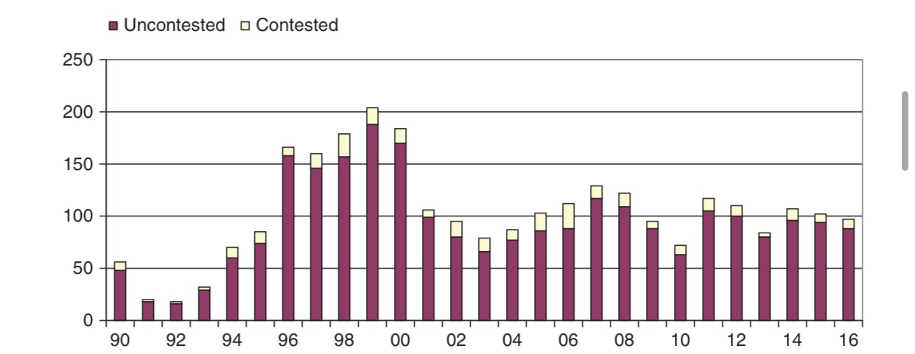
Success Rate of Tender Offers

Slide 6
Strategic advantage of the two –tier approach
Negotiation Leverage
Flexibility
Speed of Acquisition
Mitigation Risk
Cost Efficiency

Slide 7
Differences Between AON and Partial Tender Offers:
All-or-None Tender Offer
Partial Tender Offer
Can buy only a portion of shares.
Lower risk.
More flexibility (can purchase a specified portion).
Often used to acquire a significant but not majority stake.
Must buy 100% of offered shares.
Higher risk.
No flexibility (must buy all or none).
Typically used for a full takeover or full control

Slide 8
Empirical Evidence on the Effects of Tender Offers
Empirical evidence suggests that tender offers, both AON and partial, tend to produce different market reactions and long-term outcomes based on the specific characteristics of the offer and the companies involved.
Stock Price Reactions
Strategic and Operational Effects
Impact on Employees
Legal and Regulatory Impacts

Slide 9

ARE “Bad bidders” more likely to become targets?
Yes, "bad bidders" are often more likely to become acquisition targets themselves. The following factors contribute to this:
Poor post-acquisition performance, often linked to overpayment or poor integration.
Financial distress resulting from failed acquisitions.
Declining market confidence and managerial reputation.

Slide 10
Thank you
Have you any questions?

